Slide 1

What is FastAPI?
The Modern Standard: FastAPI is a high-performance web framework for building APIs with Python 3.8+ based on standard Python type hints.
Speed: It is one of the fastest Python frameworks available, rivalinga Go and NodeJS, thanks to its underlying Starlette and Pydantic engines.
Developer Experience: * Automatic Docs: It automatically generates interactive API documentation (Swagger UI) as you code.
Type Safety: Uses Python type hints to catch errors early and provide great editor support (autocompletion).

Slide 2

How It Works (The Mechanics)
Client-Server Bridge: FastAPI acts as the "Server," waiting for "Clients" (like mobile apps or web browsers) to send requests. It then processes the logic and returns data, usually in JSON format.
The ASGI Advantage: Unlike older frameworks, FastAPI is built on ASGI (Asynchronous Server Gateway Interface), allowing it to handle many simultaneous connections without "blocking" or waiting.
Deployment: It is typically paired with Uvicorn, a lightning-fast server engine that hosts the FastAPI application on a local or cloud network.

Slide 3
Welcome & Module Induction
What we learned previously: In Module 10, we mastered being "Clients." We used the requests library to fetch data from across the web and learned how to handle JSON payloads and authentication headers.
What we are learning today: We are switching sides. We are becoming the "Server." We will learn the Client-Server architecture and build our first web endpoints using FastAPI.
Why this will be helpful: In modern AI engineering, your model (like a 3D segmentation script) needs to be accessible to other apps. FastAPI allows you to wrap your Python logic into a "Service" that anyone with a URL can interact with. It is fast, professional, and industry-standard.

Slide 4
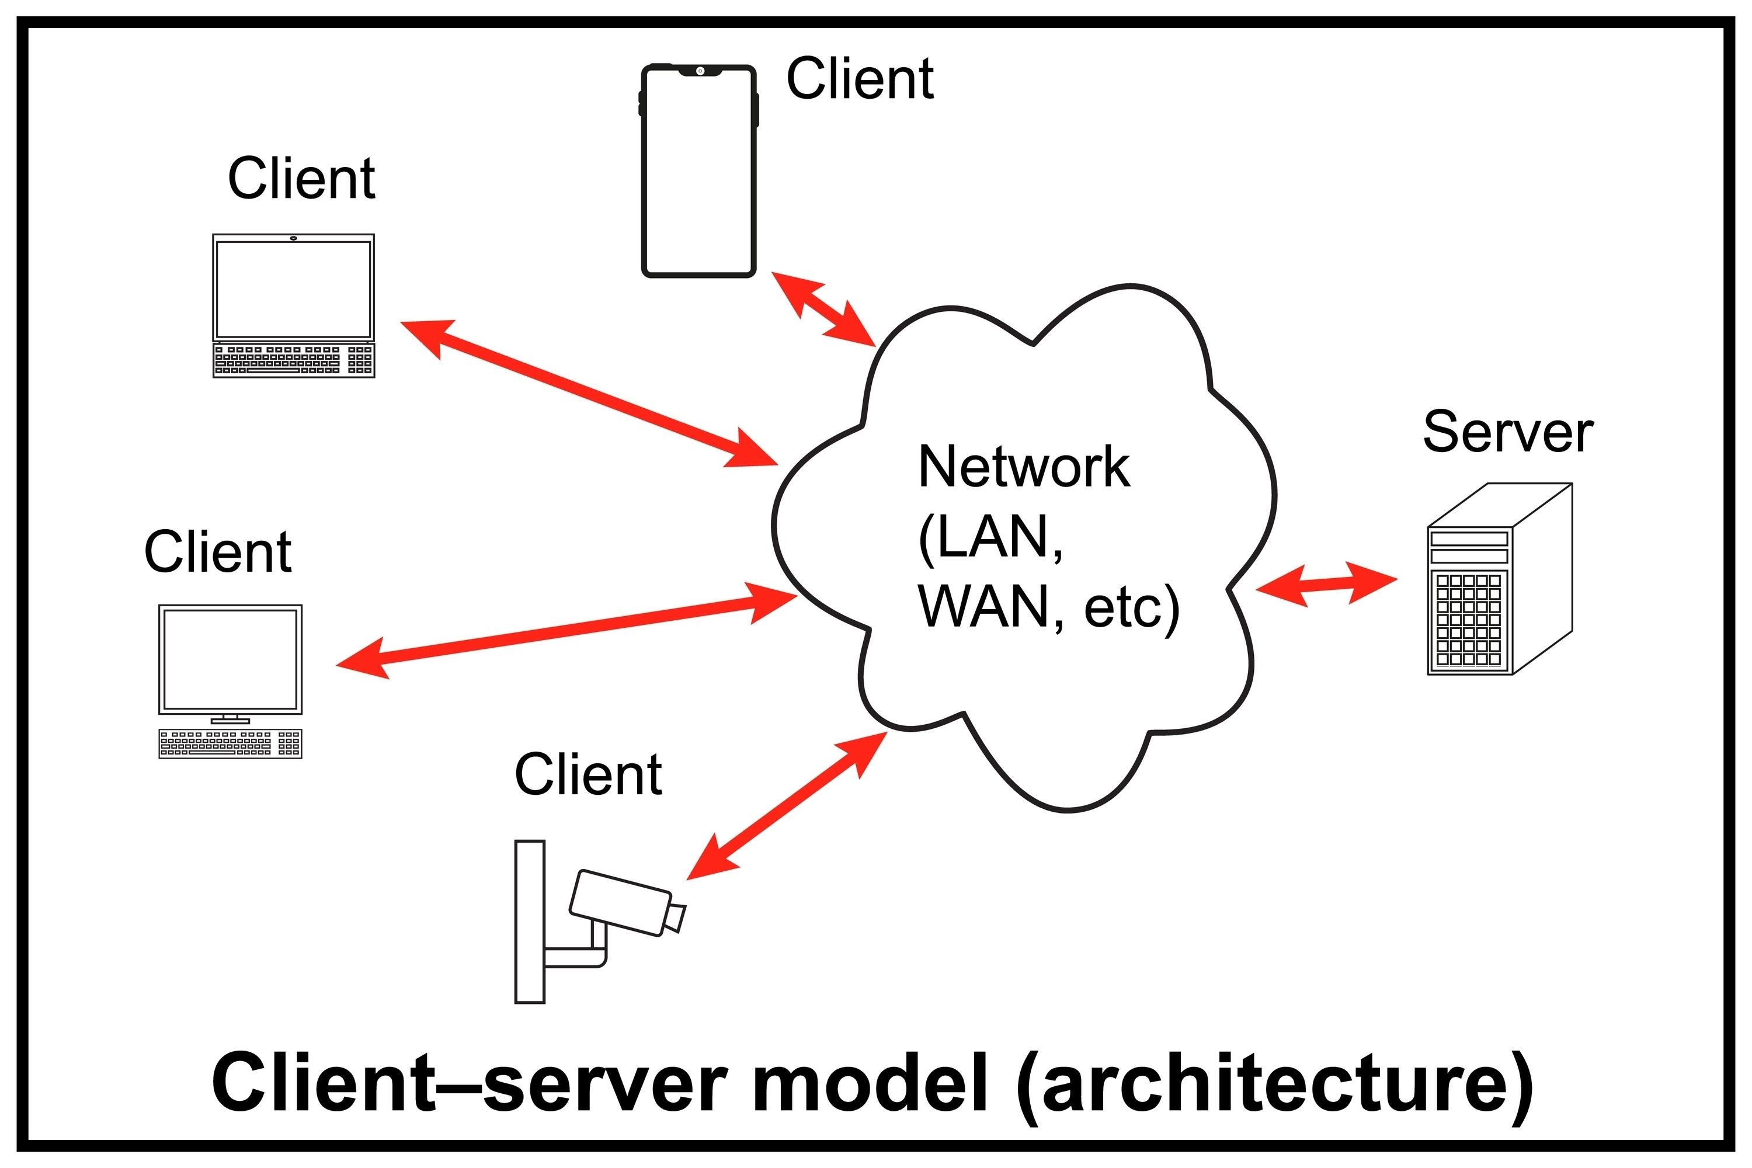
What is an API? (Client vs. Server Architecture)
The Client: The application that asks for data (like a mobile app or your scripts from Module 10).
The Server: The program that listens for requests, processes logic, and sends back a response (the "Service").
The API (Application Programming Interface): The bridge that allows them to communicate.

Slide 5
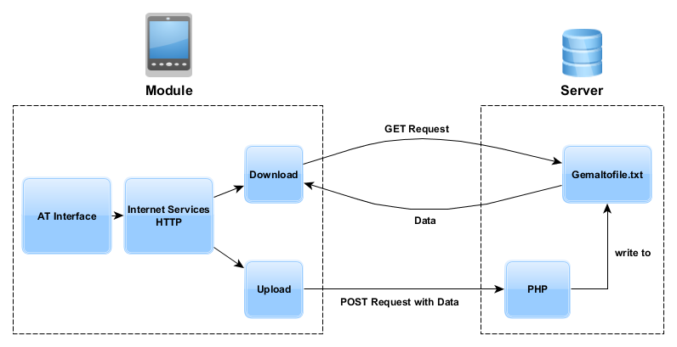
Building Your First Endpoints (GET & POST)
The GET Endpoint: Used to retrieve data. For example, checking if the AI server is online.
The POST Endpoint: Used to send data to the server. For example, uploading an image file for processing.
Automatic Docs: FastAPI automatically generates a professional "Swagger" UI at /docs so users know exactly how to use your tool.

Slide 6
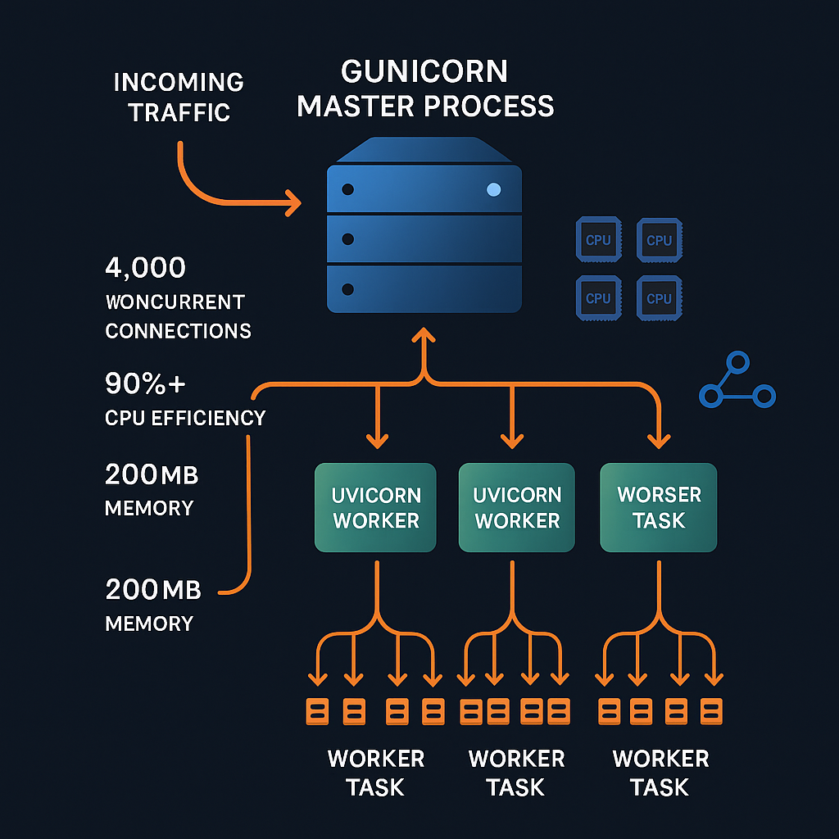
Uvicorn & Local Hosting
The Engine: While FastAPI is the code, Uvicorn is the lightning-fast engine (ASGI server) that runs it.
Localhost: Your computer will act as the server, listening on port 8000. You can access it at http://127.0.0.1:8000.

